Slide 1
Schedule option 2; 3.5h
To be removed from final slide deck
intro
put together things that belong together
classes
what does not belong? e.g. plotting
there are many ways to build a class (serialization)
break out what varies 1 (initializers, solvers, ...)
functions, classes, etc – everything can be passed around
start with solver
what is an interface, duck typing
then discuss constructor: __init__ vs from_initializer
keep it open for extension
hooks
break out what varies 2
recurrent research project concepts: projects, experiments, runs
break out data and code
what is lineage, versioning
break out run parameters and code
what is parameters injection
how is this more flexible? final discussion
imagine you need to make a change, or test a new thing

Slide 2
Start: ask who has written a class before
To be removed from final slide deck
Mix them so they’re paired with someone who didn’t

Slide 3

Scientific programming patterns
Lisa Schwetlick and Pietro Berkes

Slide 4

What is wrong with y’all?!
You studied the language
You learned the libraries
You coded for months
And yet the code still feels like a 7-heads apocaliptic monster. Changes are painful, new features break old functionality, reproducing previous results becomes a git-checkout juggling exercise

Slide 5
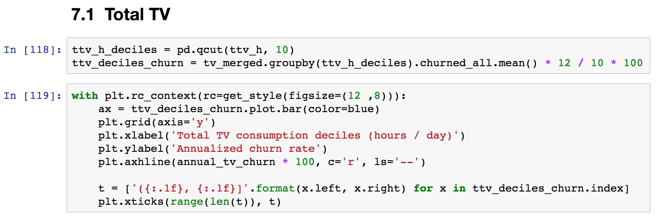
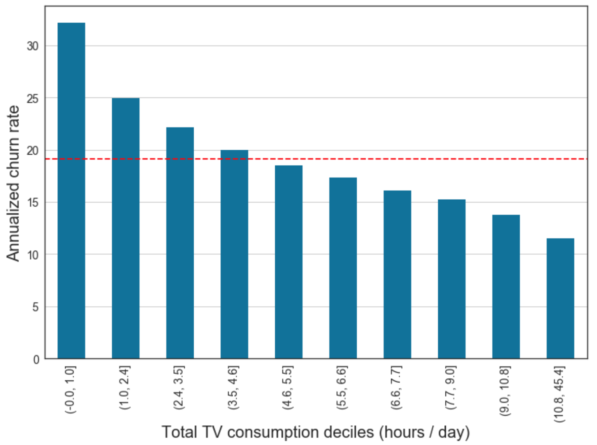
The good news: you can smell it

Slide 6
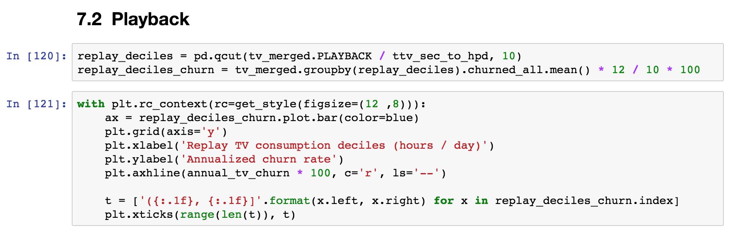
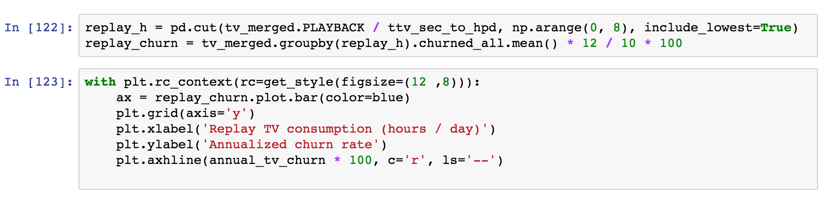
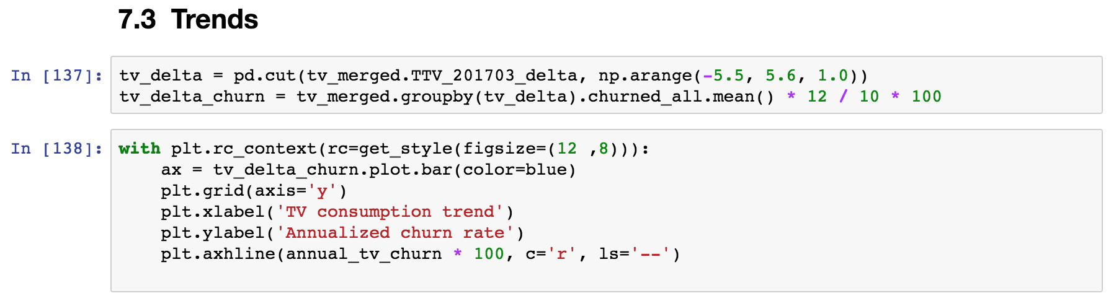
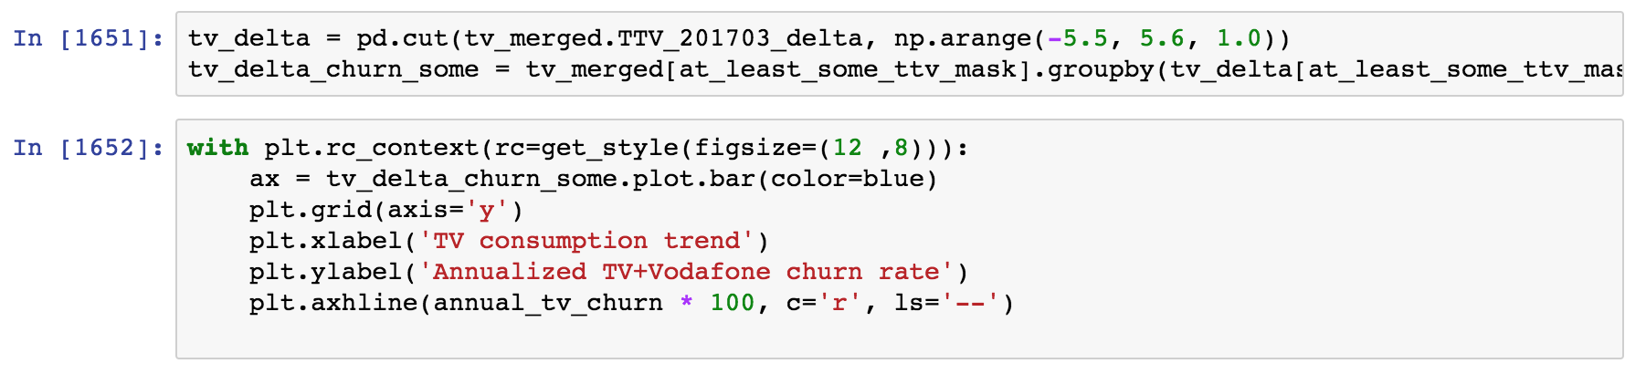
The good news: you can smell it

Slide 7
What is wrong with smelly code?
Smell code might work right now, but in time it is going to have one or more of these issues:
Redundant: an update in one place would need to be duplicated multiple times
Not flexible: adding new functionality and modifying exiting features require extensive rewrites or hacks
Hard to read and test: the code that performs the interesting computation is mixed with the code that does the repetitive boilerplate

Slide 8
Here is how to fix it, class dismissed
What are you missing? A few patterns that make your code odor as nice as a spring meadow
Put together things that belong together
Break out things that vary independently
Keep code open for extension
Notes:
These constructs are not very common in scientific code, and you don’t actually ”need” them. But the same is true of functions!

Slide 9
To be removed from final slide deck
We’ll show some code, and put it together and break it apart several times to illustrate how to make it practical to use, but flexible
Then we’ll discuss how to do a similar thing at a research project level

Slide 10

Chapter 1: Introduction to classes Put together things that belong together

Slide 11
Open discussion
To be removed from final slide deck
We’ll start by looking at putting things together that belong together
How do we know what does?
We know data structures that groups data together, lists, dictionaries, etc; and modules and packages that organize code with a similar scope
Here we’ll look at functions and classes as a way to group data and dunctionality together in a way that is easy to use but remain flexible to changes

Slide 12
Go to “classes” notebooks

Slide 13
Hands-on: Turn the walker code into a class
Submit a PR for Issue #1 on GitHub.
Have a look at the “Hands-on Walker Step 0” notebook
Create a copy of the notebook, and group things that belong together by writing a Walker class!

Slide 14
After exercise, open discussion notes
To be removed from final slide deck
Classes group data and functions that belong together
Classes are used to put together sets of parameters that belong together and would be otherwise passed over and over to a set of functions
Classes are templates for bundles of data and “methods”, i.e. functions that have access to the data stored in an instance
How is the code with the class better?
all parameters are specified once at the start, grouped together nicely the signature of most functions is simplified
What belongs and do not belong to a class?
Anything for which you can imagine to write 5 different variants depending on your mood
For example, plotting code: write functions that take instances and create a plot instead. This also helps separating the dependencies from plotting libraries from the computational code. Related to Model-View pattern
Smell: a method that does not use any of the data in the instance
Which methods should be private?
think about the “interface”, i.e. the part of the class that an external user is supposed to use directly
Design questions
- should i, j belong to the class? - should random_state belong to the class?
What are the smells that remain?
# need to do the bookkeeping for i, j in case you want to create / simulate entire trajectories # changing the next step probability is going to be trouble # adding a new activation map requires adding a new piece to the code # what if map_type is not any of the 3?

Slide 15
Summary: One of the smell of classes
def first_function(x, y, z):
# Something
def second_function(x, y, z):
# Something else
def third_function(x, y, z):
# Something more
The same set of parameters is needed for a set of functions. In code calling this function, one needs extra code to keep these parameters in sync.
class Xyz:
def __init__(self, x, y, z):
...
def first_function(self):
# Something
def second_function(self):
# Something else
def third_function(self):
# Something more
… becomes …

Slide 16
Chapter 2: There are many ways to build an instance Break out things that vary independently

Slide 17
There are many ways to build an instance
In tests, typically one wants to specify all the parameters *exactly*
Sometimes there are multiple ways of setting the parameters, e.g. setting the initial weights in a neural network
The instance could be created from some saved parameters (serialization)
Open discussion notes:
Look at Walker class, if/elif part – that’s an example of having multiple ways of initializing the activation_map.
What do you think of it?
Have you seen this kind of situation before?
What happens if we want to add a new activation map type?
What if a colleague wants to do the same?
What happens if I want to test that one of the initializations is correct?
What do you think is the smell, and how would you fix it?
To be removed from final slide deck

Slide 18
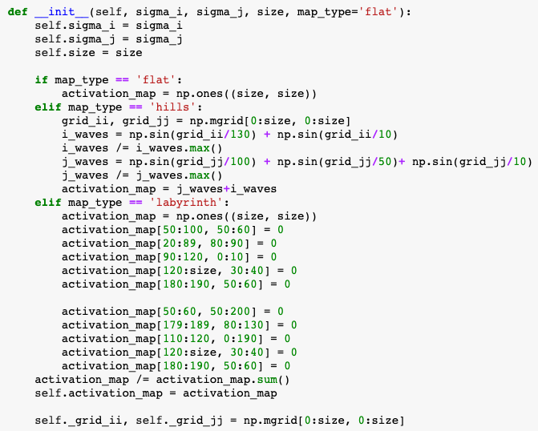
The smells of the Walker constructor

Slide 19
The smells of the Walker constructor
The constructor will become longer with more initialization methods
We need to define constructor parameters that are not used in some code paths
Most constructor parameters are never used again
How would you fix it?

Slide 20
The smells of the Walker constructor
The constructor will become longer with more initialization types
We need to define constructor parameters that are not used in some code paths
Most constructor parameters are never used again
These are smells of the fact that the initialization of activation_map varies independently of the class Walker
We need two ingredients to fix this

Slide 21
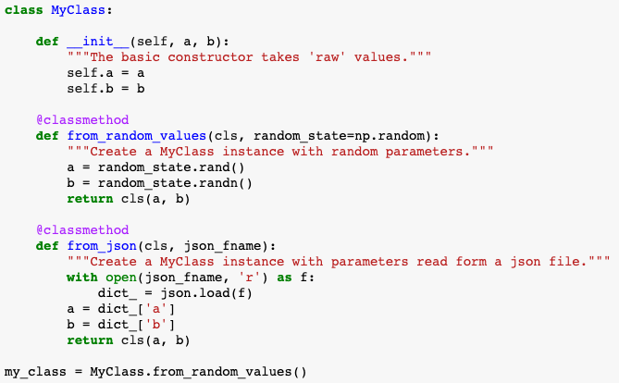
Factory methods build instances in different ways
The main constructor should not do anything fancy
The factory methods create the parameters in some fancy way, then call the basic constructor
A @classmethod is a method that takes a reference to the class, not the instance, as its input
Their main use is as factory methods, to create instances

Slide 22
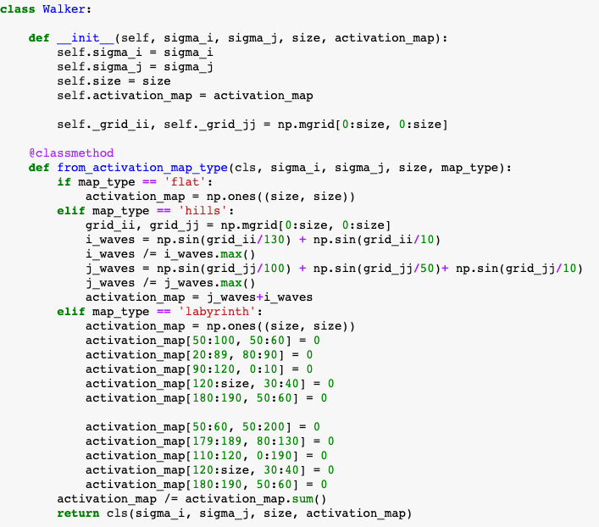

Factory methods take us only this far...
The constructor factory method will become longer with more initialization types
We need to define constructor factory method parameters that are not used in some code paths
Most constructor parameters are never used again

Slide 23

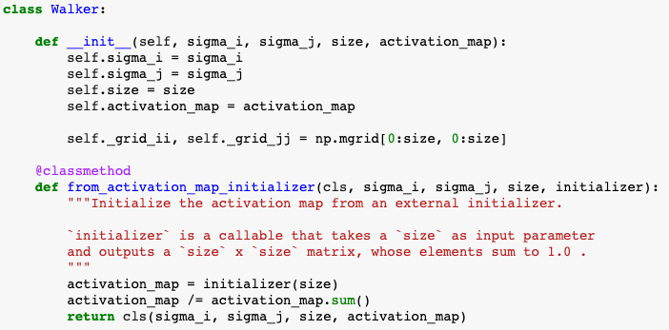
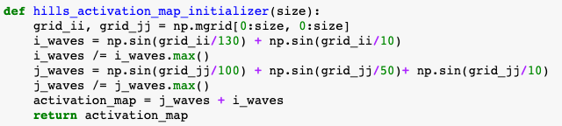
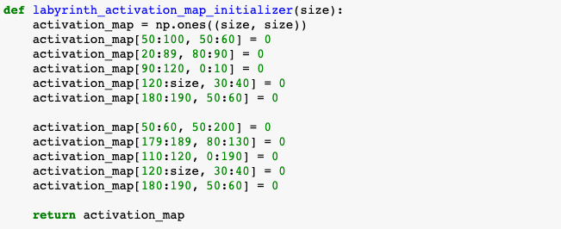
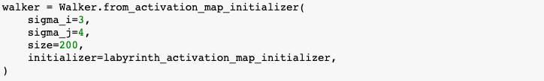
Break out the part that varies!

Slide 24
Break out the part that varies!
Open discussion notes:
By breaking out the parts that can vary (initializers), the model code is much simplified. All you need to do is define the interface for the initialization method
You can add a new initialization method without touching the model! Changes to the initializers also do not affect the Walker. The code became much more flexible
We can test the initializer methods much more easily; the model as well, as we can now define a new TestInitializer that sets the ”x” to a convenient initial value
This pattern is called “dependency injection”
what to do if one initializer had a parameter?
To be removed from final slide deck

Slide 25
Here the exercise about breaking out the next step probability

Slide 26
Persistence
Serialization, show the code

Slide 27
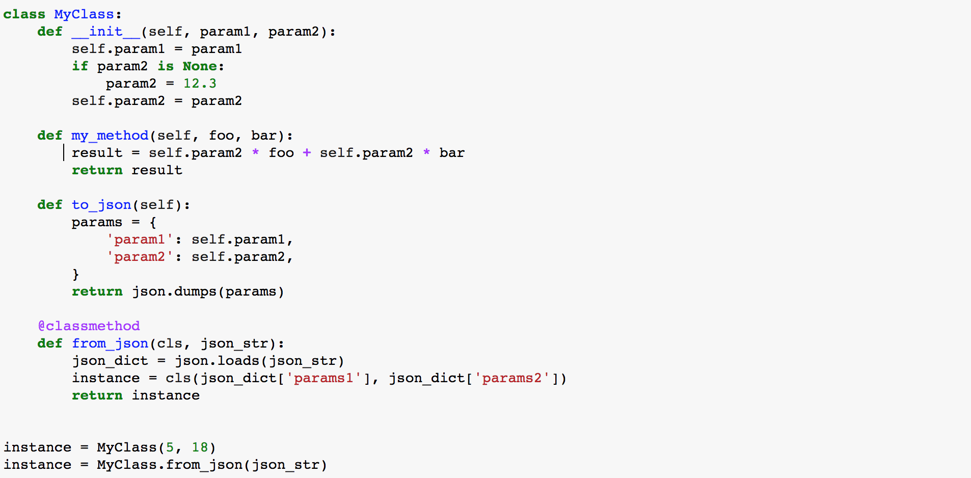
Recap: Class structure
The constructor is used to first populate an instance, called by convention “self”
Classes can define “methods”, i.e. functions that have access to the data stored in an instance
A ”class method” can be used to build an instance in some alternative way, e.g. using data from a file
Here is how you create instances from the constructor or a class method

Slide 28
Architecture discussion?
Walker.from_data(data)
walker.fit(data)
walker_from_data(data), return fitted instance
trajectory from walker
walker.trajectory(n_steps) (hooks might be useful)
trajectory(walker, n_steps) (hooks not so useful – just write another trajectory creator)

Slide 29
Separate what varies independently Part 2 The same principle applies everywhere, including at the level of project

Slide 30
Common concepts in research projects
break out run parameters and code
what is parameters injection
manager code: small amount of code reads the run parameters, create the appropriate classes, injects the parameters, and runs
it’s a coordination job, all the science is done elsewhere
separate calculation and analysis of results
recurrent research project concepts: projects, experiments, runs
break out data and code
data not in git
what is lineage, versioning
Some “input” data is common to the whole project

Slide 31
Keep things open for extension

Slide 32
Hooks patterns
common cases:
in graph traversing algorithms (e.g., depth-first search) the graph traversing is generic, but the operation to be done with the data on the nodes is specific to the application. Graph libraries often implement the traverversing, and allow implementing the operation through hooks (hook when first visiting node, and when all children are visited on the way back)
in some UI frameworks, hooks can be added to react to certain UI events

Slide 33
Thank you!

Slide 35
The good news: you can smell it
You’re here because you started feeling the “code smell”
Scientists in the wild tend to write this…
What is the smell of the code in the notebooks?
Notes:
“code smell” is an actual technical term!
~/n/employees/MatthieuHarbich/generative/ Open Generative%20model%20-%20Mixture%20of%20gaussians_EM_markovModels_soft_clustering-plotLH-C%2BCLEAN-LH_TEST-4k-Copy1.ipynb
Then open any other with similar name
It smells like you need a Python module

Slide 36
Objective
This is a code smell detection crash course for scientific programming
What are you missing? A few patterns that make your code odor as nice as a sunny meadow
Notes:
These constructs are not very common in scientific code, and you don’t actually ”need” them. But the same is true of functions!

Slide 37
Schedule option 1
intro
decorators: functions are just like any other value
classes
put together things that belongs together
what does not belong? e.g. plotting
there are many ways to build a class (serialization)
break out what varies 1 (initializers, solvers, ...)
what is an interface, duck typing
break out what varies 2
recurrent research project concepts: projects, experiments, runs
break out data and code
what is lineage, versioning
break out run parameters and code
what is parameters injection
how is this more flexible?
imagine you need to make a change

Slide 38
Setting up and cleaning up: The smell of context managers

Slide 39
Ask: what’s the smell of classes? what are classes good for
Expected:
remove repeated parameters (encapsulate things that belong together)
specialize behavior with inheritance
Ask: what belongs to a class

Slide 40
The smell of classes
def first_function(x, y, z):
# Something
def second_function(x, y, z):
# Something else
def third_function(x, y, z):
# Something more
The same set of parameters is needed for a set of functions. In code calling this function, one needs extra code to keep these parameters in sync.
… becomes …
def first_function(xyz):
# Something
def second_function(xyz):
# Something else
def third_function(xyz):
# Something more
class Xyz:
def __init__(self, x, y, z):
...

Slide 41
Go to “classes” notebooks

Slide 42
Recap: Classes
Classes are used to get rid of set of parameters that belong together and are passed over and over to a set of functions
Classes are templates for bundles of data and “methods”, i.e. functions that have access to the data stored in an instance
A ”class method” is used to build an instance in some alternative way, e.g. using data from a file

Slide 43
Another smell of classes
for data in list_of_data:
if data['type'] == 'TYPE1':
type1_foo(data)
type1_bar(data)
elif data['type'] == 'TYPE2':
type2_foo(data)
type2_bar(data)
Several “specializations” of conceptually similar functions
… becomes …
Classes may have methods with the same interface, the class type determines the “specialization”.
One can even define a hierarchy of classes where some methods are re-used!
for instance in instances:
instance.foo(data)
instance.bar(data)

Slide 44
Another smell of classes – simple example
for data in geometric_objects:
if data['type'] == ‘SQUARE':
area = area_square(data)
elif data['type'] == ‘CIRCLE':
area = area_circle(data)
Several “specializations” of conceptually similar functions
… becomes …
Classes may have methods with the same interface, the class type determines the “specialization”.
One can even define a hierarchy of classes where some methods are re-used!
for instance in geometric_objects:
area = instance.area()

Slide 45
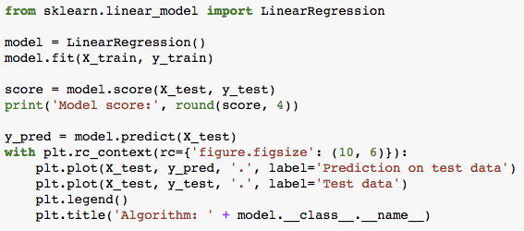
Real example: sklearn
Model score: 0.0066

Slide 46
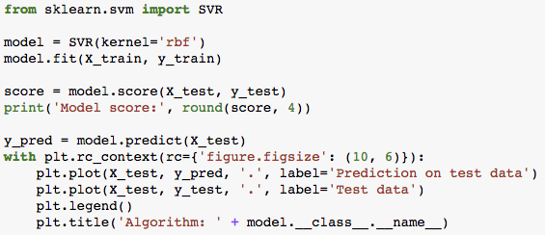
Real example: sklearn
Model score: 0.6144

Slide 47
A general principle: separate things that vary independently

Slide 48
Examples:
initializer
solver
How about plotting?

Slide 49
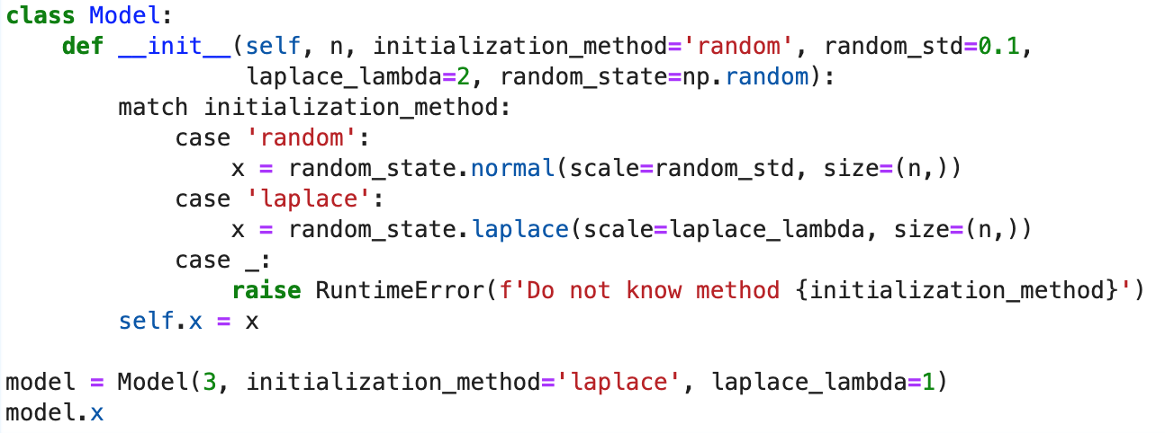
Ask for thoughts from students. Write their thoughts on whiteboard
To lead discussion:
what do you think? have you seen this kind of situation before?
what happens if I need to add a new initialization?
what happens if I want to test that the initialization is correct?
what do you think is the smell?
At end of discussion, the conclusion should be that the initialization is somehow independent, that it can vary independently from the model itself
Ask again: what do you suggest we do about it?

Slide 50
The summary should include these points
Smells:
the constructor will become longer with more initialization methods
we needed to define constructor parameters that are not used in some code paths
even worse, most constructor parameters are never used again
we need to take care of errors if we pass a method string that does not exist

Slide 51
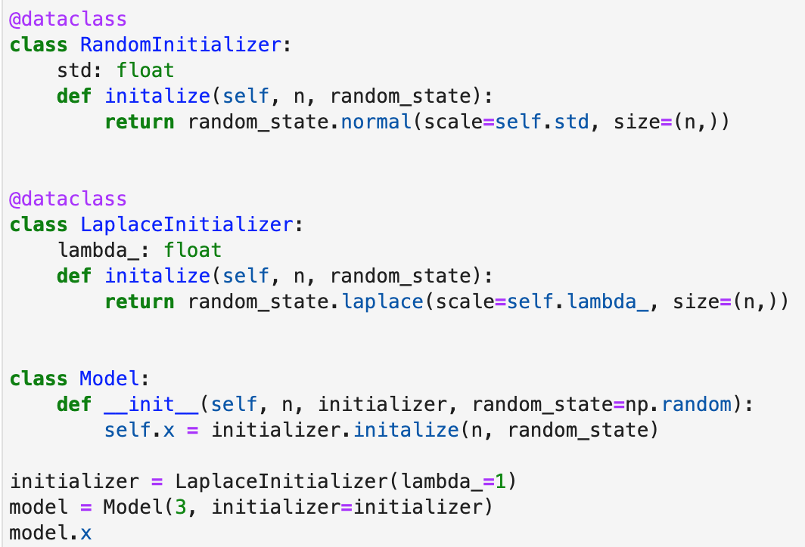
Introduce idea: functions are like any other value
It helps to think what we would like to write instead:
(maybe this but “initializer” is a function)
do you want to try and see if you can transform that Model class so that it looks like this?

Slide 52
How to separate?
Functions and objects are just like any other value

Slide 53

Ask: what do you think of this solution? Write down the sudents’ thoughts
By breaking out the parts that can vary (initializer), the model code is much simplified. All you need to do is define the interface for the initialization method
Parameters are confined to where they are useful
You can add a new initialization method without touching the model! The code became much more flexible
We can test the initializer methods much more easily; the model as well, as we can now define a new TestInitializer that sets the ”x” to a convenient initial value
This pattern is called “dependency injection”
Exercise: give another class with one solver, now we want to add a second one -> break it out and inject it!

Slide 54
The same principle applies everywhere, including at the level of project

Slide 55
Common concepts in research projects
Some “input” data is common to the whole project

Slide 56
Where to go from here…
realpython.com

